Slide 1


PEOPLE’S EDUCATION TRUST (R), MANDYA
P.E.S. COLLEGE OF ENGINEERING MANDYA - 571401
(An Autonomous Institution under VTU, Belagavi, Aided by Govt. of Karnataka.)
Mini Project Presentation
Department of Artificial Intelligence and Machine learning
"KCET COLLEGE PREDICTOR AND AI ADVISOR”

Slide 2


THE TEAM
Team Name : Team Valvo
Team Leader : Pranathi B H (4PS22CI038)
Team Members Details:
Pranathi B H (4PS22CI038)
Vikas R P (4PS22CI056)
Srinidhi Prabhu MU (4PS22CI049)
Hardik Jain (4PS22CI014)

Slide 3

PROBLEM STATEMENT
After KCET results are announced, students often face confusion regarding:
● Which colleges they are eligible for based on their rank.
● The next steps in the admission process.
● How document verification is done.
● Probable colleges they can get into.
● How to complete option entry

Slide 4
IDEA/APPROACH
We propose a web application that simplifies the KCET admission journey. By allowing students to input their KCET rank, preferred location, and category, the platform will generate a personalized dashboard displaying probable college options based on historical cut-off data.
In addition, an AI-powered chatbot will provide real-time answers to KCET-related queries using Gemini 2 Flash (an LLM by Google), helping students with accurate, instant support throughout the process.

Slide 5
Objectives
Develop a user-friendly website with a personalized dashboard showing eligible/probable colleges.
Integrate an intelligent chatbot to answer KCET-related questions.
Provide smart, AI-driven recommendations to guide students through the admission process.

Slide 6
Literature Survey
System Evolution
Traditional: Manual counseling, paper-based (Pre-2000s)
Digital: Basic web portals, simple filtering (2000-2010)
Modern: AI-enhanced, personalized systems (2010-Present)
Existing Solutions
Commercial
Careers360
CollegeDekho
Shiksha.com
Government
Official KCET Portal
Basic counseling systems

Slide 7
Advantages Over
Existing Systems
AI-powered personalized recommendations
Real-time interactive chatbot
Modern, user-friendly interface
Efficient rank-based filtering
Location-aware suggestions

Slide 8
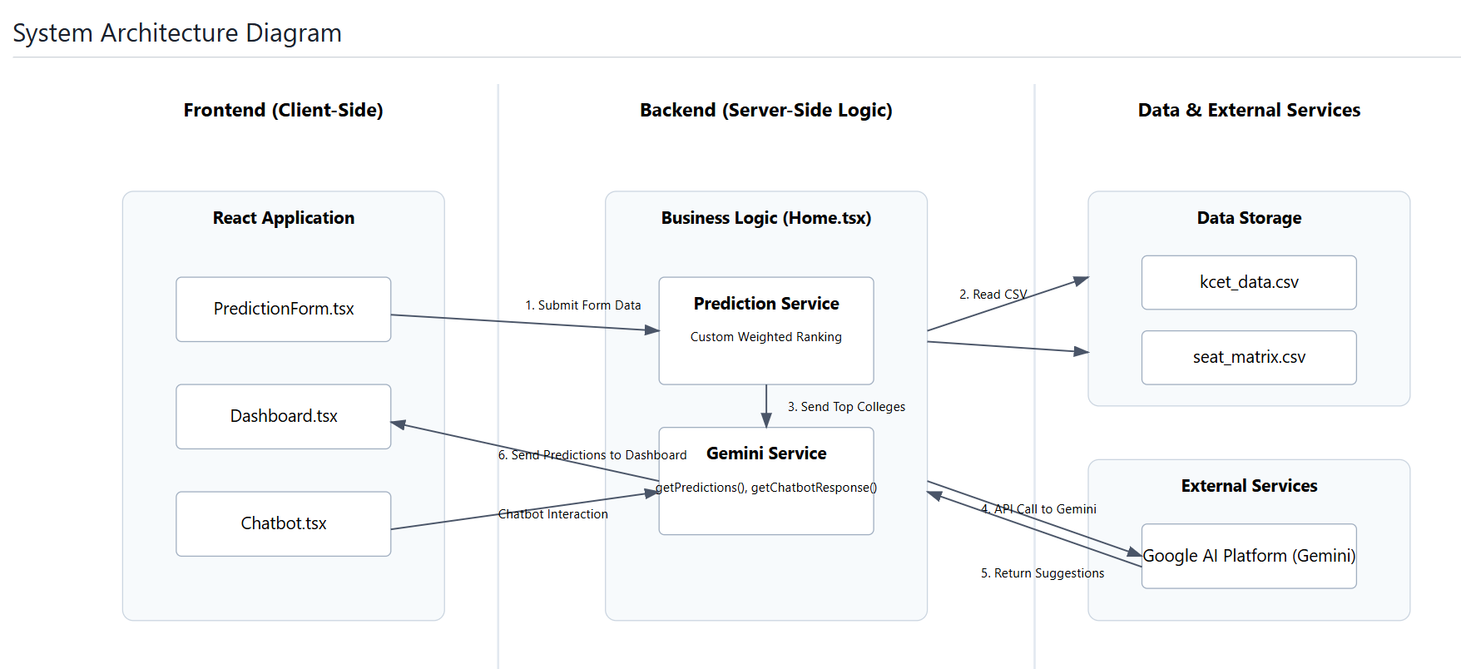

Slide 9
FEATURES &
TECH STACK
Frontend Framework:
React 18.3.1 with TypeScript
Vite as the build tool and development server
Styling and UI:
Tailwind CSS for styling
Modern responsive design with grid layout
Custom components for forms and dashboard
Data Processing and Visualization:
PapaParse for CSV parsing
Recharts for data visualization
React Query for data fetching and caching
AI Integration:
Google's Generative AI (@google/generative-ai) for predictions and chatbot
Custom integration with Gemini API
Development Tools:
TypeScript for type safety
ESLint for code quality
PostCSS and Autoprefixer for CSS processing

Slide 10
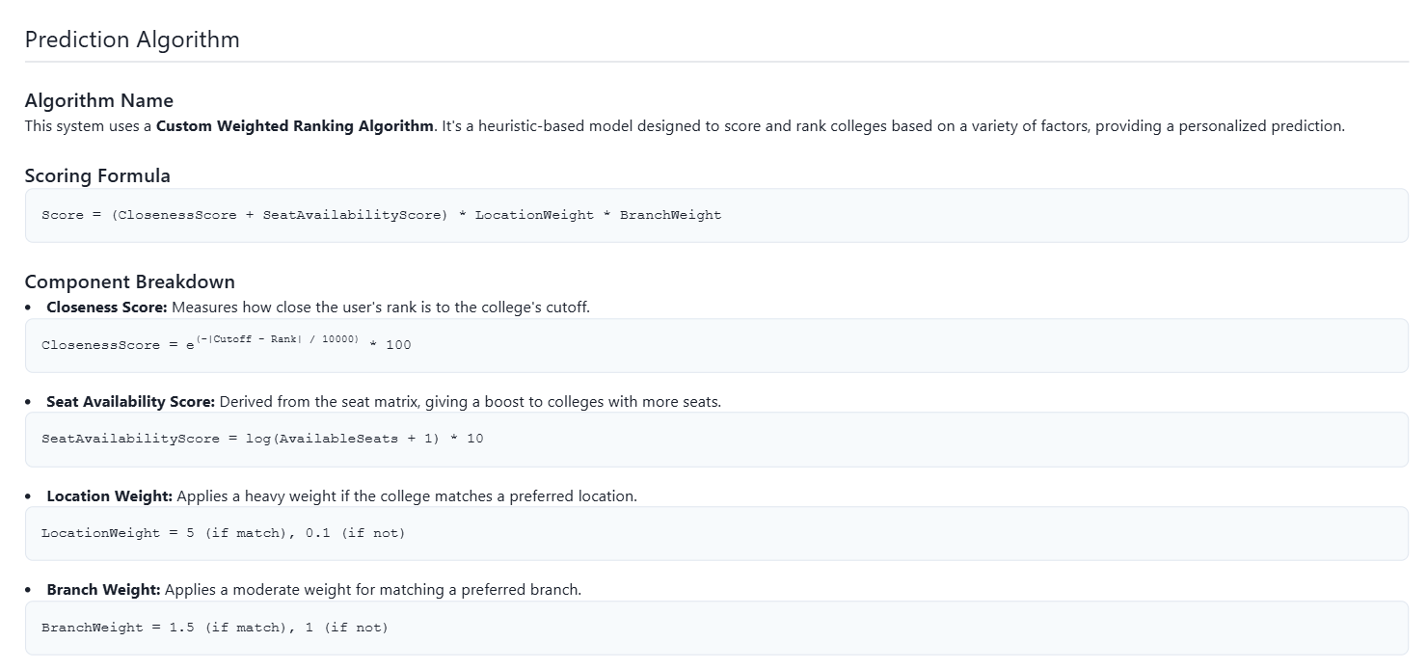

Slide 11
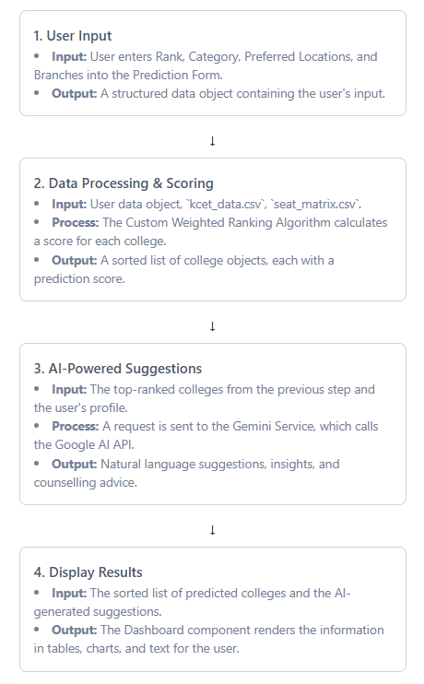
User Flow
Enter Website
Input Details – KCET Rank, Preferred Location, Category, Branch
Submit Form
Receive Results – Personalized list of probable colleges with smart recommendations
Chatbot Assistance – Get instant, AI-powered answers to all KCET-related queries

Slide 12
Research Impact
Improved student decision-making
Efficient college selection process
Reduced counseling time
Better accessibility to information
Data-driven recommendations

Slide 13
Future Scope
Deep learning integration
Advanced pattern recognition
Historical trend analysis
Success rate prediction
Enhanced personalization

Slide 14
Conclusion
This platform will simplify the KCET admission process by providing personalized college predictions, AI-driven insights, and real-time assistance, helping students make informed decisions with confidence.

Slide 15
THANK YOU
PES COLLEGE OF ENGINEERING MANDYA

